Slide 1
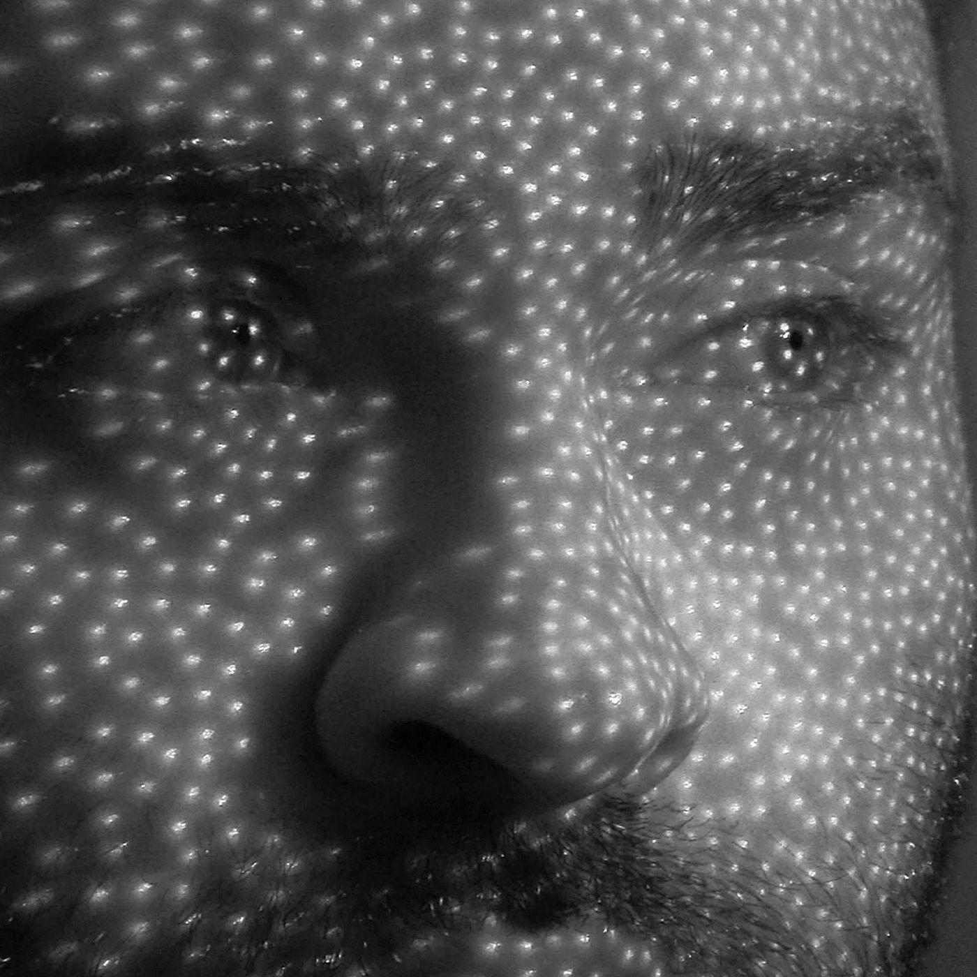
CNN: Convolution
& Pooling
How machines extract features and shrink them down
Part 1: Convolution & Feature Extraction
Part 2: Pooling Layers
Session 19 & 20 · Deep Learning

Slide 2
PART 1
Convolution & Feature Extraction
How a CNN detects edges, shapes, and patterns from raw pixels

Slide 3
What Is Convolution?
The core operation CNNs use to detect patterns in an image
Convolution is an operation used in CNNs to detect important patterns and features from an image.
A CNN Learns to Detect...
Edges
Corners
Lines
Textures
Shapes
Objects (eyes, ears, wheels...)
The main idea: Image + Filter/Kernel → Feature Map
CNN: Convolution & Pooling
3

Slide 4
What Is a Kernel / Filter?
A small matrix that moves over the image and performs calculations
Image (5×5, all pixels = 5)
3×3 Kernel (detects vertical edges)
5 5 5 5 5
1 0 -1
5 5 5 5 5
5 5 5 5 5
1 0 -1
5 5 5 5 5
1 0 -1
5 5 5 5 5
Easy definition: Kernel = small matrix used to detect specific features in an image.
CNN: Convolution & Pooling
4

Slide 5
How Convolution Works
Multiply corresponding values, then add them together
Image
Kernel
Overlap top-left 2×2
1 2 3
1×1 + 2×0
4×0 + 5×1
1 0
4 5 6
0 1
7 8 9
1 + 0 + 0 + 5 = 6
The first value of the feature map is 6. The kernel then slides to the next position and repeats.
CNN: Convolution & Pooling
5

Slide 6
What Is Stride?
How many pixels the filter moves at each step
Stride = 1
Stride = 2
The filter moves one position at a time.
The filter jumps two positions at a time.
Filter covers positions 1,2,3,4,5 — one step at a time
Filter skips positions — covers less ground per pass
Easy definition: Stride = number of pixels the kernel moves across the image. Larger stride → smaller feature map.
CNN: Convolution & Pooling
6

Slide 7
What Is Padding?
Adding extra pixels around the border, usually zeros
Original (3×3)
After Zero Padding (5×5)
1 2 3
0 0 0 0 0
4 5 6
0 1 2 3 0
7 8 9
0 4 5 6 0
0 7 8 9 0
Why Use Padding?
0 0 0 0 0
Preserve image size
Allow edge pixels to participate more
Prevent information loss at boundaries
Valid padding = no padding
Same padding = pad so output size stays the same
CNN: Convolution & Pooling
7

Slide 8
What Is a Feature Map?
The result of applying a filter to an image
Input Image
→
Filter
→
Convolution
→
Feature Map
Different Filters Detect Different Features
Filter 1
Filter 2
Filter 3
Filter 4
Vertical edges
Horizontal edges
Corners
Textures
The output produced after applying a filter to an image is called a feature map or activation map.
CNN: Convolution & Pooling
8

Slide 9
NumPy Practical: Convolution
Implementing convolution manually
import numpy as np
image = np.array([
[1, 2, 3, 4],
[5, 6, 7, 8],
[9, 10, 11, 12],
[13, 14, 15, 16]
])
kernel = np.array([
[1, 0],
[0, 1]
])
output = np.zeros((3, 3))
for i in range(3):
for j in range(3):
region = image[i:i+2, j:j+2]
output[i, j] = np.sum(region * kernel)
print(output)
Output
7 | 9 | 11
15 | 17 | 19
23 | 25 | 27
First calculation:
1×1 + 2×0 + 5×0 + 6×1
= 1 + 6 = 7
CNN: Convolution & Pooling
9

Slide 10
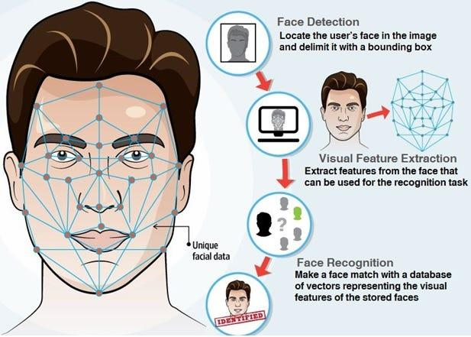
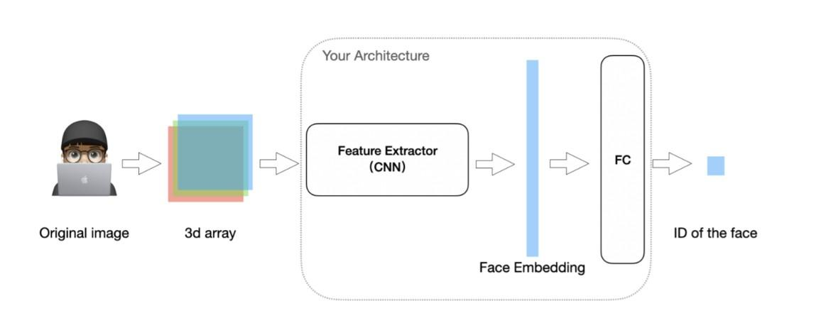
Real-World Example: Face ID & Convolution
iPhone Face ID uses a CNN to extract facial features
A CNN acts as a feature extractor: the original image becomes a 3D array, then a face embedding.
Detection → Feature Extraction → Recognition — the same convolution + feature map idea, applied to faces.
CNN: Convolution & Pooling
10

Slide 11
PART 2
Pooling Layers
Shrinking feature maps while keeping the important information

Slide 12
What Is Pooling?
Reduces the size of a feature map while keeping the important information
Feature Map (4×4)
After 2×2 Max Pooling (2×2)
1 3 2 4
5 6 7 8
6 8
9 2 3 1
9 7
4 5 6 7
Each 2×2 region collapses into a single value — take the maximum from each region.
CNN: Convolution & Pooling
12

Slide 13
Max Pooling vs. Average Pooling
Two ways to summarize a region
Max Pooling
Average Pooling
2 5
7 3
2 5
7 3
Maximum = 7
Average = (2+5+7+3)/4 = 4.25
Max Pooling | Average Pooling
Takes maximum value | Takes average value
Keeps strongest feature | Keeps overall information
Commonly used in CNNs | Less common in modern CNNs
CNN: Convolution & Pooling
13

Slide 14
Why Does Pooling Help?
100×100 image → 100×100 after convolution → 50×50 after 2×2 pooling
Reduce Computation
Reduce Memory
Keep Important Features
Translation Tolerance
Smaller feature maps need fewer calculations
Less data needs to be stored
Max pooling keeps strong activations
Small shifts in feature position matter less
100 × 100 → Convolution → 100 × 100 → 2×2 Pooling → 50 × 50
CNN: Convolution & Pooling
14

Slide 15
Pooling Code & Combined Workflow
Convolution followed by max pooling
feature_map = np.array([
[1, 3, 2, 4],
[5, 6, 7, 8],
[9, 2, 3, 1],
[4, 5, 6, 7]
])
output = np.zeros((2, 2))
for i in range(2):
for j in range(2):
region = feature_map[
i*2:i*2+2, j*2:j*2+2]
output[i, j] = np.max(region)
print(output)
# [[6. 8.]
# [9. 7.]]
Conceptual Flow
4×4 Image
↓
Convolution
↓
3×3 Feature Map
↓
2×2 Max Pooling
↓
1×1 Output
CNN: Convolution & Pooling
15

Slide 16
Complete CNN Flow
From raw pixels to a prediction — the full picture
1
Input Image
2
Convolution
3
Feature Map
4
Activation (ReLU)
5
Pooling
6
More Conv + Pooling
7
Flatten
8
Dense Layer
9
Prediction
CNN: Convolution & Pooling
16

Slide 17
Example: Cat / Dog Classifier
The same flow, applied to a real classification task
Image
↓
Convolution → Detect edges
↓
Pooling
↓
Convolution → Detect shapes
↓
Pooling
↓
Convolution → Detect eyes/ears/fur
↓
Dense Layer
↓
Cat / Dog
CNN: Convolution & Pooling
17

Slide 18


Real-World Example: Face ID Full Pipeline
Detection, alignment, and matching — powered by conv + pooling
TrueDepth captures depth + infrared data, a CNN extracts facial features into an embedding, and pooling keeps the pipeline fast enough to run in real time on your phone.
CNN: Convolution & Pooling
18

Slide 19
Real Dataset for Practice: MNIST
Handwritten digits — the classic dataset for learning CNNs
Dataset Info
How the CNN Learns
Digits 0 through 9
MNIST Image
Each image is 28 × 28 pixels
Convolution → Edges
Pooling → Shapes
Thousands of labeled examples
Convolution → Digit patterns
Built into TensorFlow / Keras
Dense Layer → 0-9 prediction
CNN: Convolution & Pooling
19

Slide 20
Key Takeaways
Convolution slides a small kernel over an image, multiplying and summing values to build a feature map.
Stride controls how far the kernel jumps; padding keeps edge pixels from being underused.
Different filters detect different features — edges, corners, textures — stacked into deeper patterns.
Pooling (usually max pooling) shrinks feature maps, cutting computation while keeping strong signals.
The full CNN flow: Convolution → Activation → Pooling, repeated, then Flatten → Dense → Prediction.
Real-world systems like Face ID combine exactly these building blocks — feature extraction and pooling — to run fast, on-device recognition.
CNN: Convolution & Pooling
20

